Slide 1
UNIT -V

Slide 2
Software Metrics: Software Quality, Metrics for Analysis Model, Metrics for Design Model, Metrics for source code, Metrics for testing, Metrics for maintenance

Slide 3
Software Quality
McCall’s quality factors
Factors that affect software quality can be categorized in two broad groups:
Factors that can be directly measured (e.g. defects uncovered during testing)
Factors that can be measured only indirectly (e.g. usability or maintainability)

Slide 4
Product metrics
Product metrics for computer software helps us to assess quality.
Measure
When you obtain/observe/measure a value of directly observable property of an entity, you have a measure
. Each measure has a standard unit of measure (UOM) like seconds, meter, kilograms etc.
In software development and software testing, most commonly used measures are:
•Number of Defects found in a system or component
•Lines of Code (LOC, kLOC)
• Number of Test Cases

Slide 5
Product metrics
Metric
A metric in contrast, is a derived value which cannot be observed/measured directly.
It is a number derived from one or more measures by a formula (or estimation).
Best known metrics in software development and software testing are:
•Number of defects found per kLOC, which serves as an estimation of quality of code
• Productivity, i.e. Size / Effort
Indicator
-- An indicator is “a thing that indicates the state or level of something”, thus it can be simply just a number showing value of a particular measure or metric.
A metric or a combination of metrics that provide insight into the software process, a software project or a product itself

Slide 6
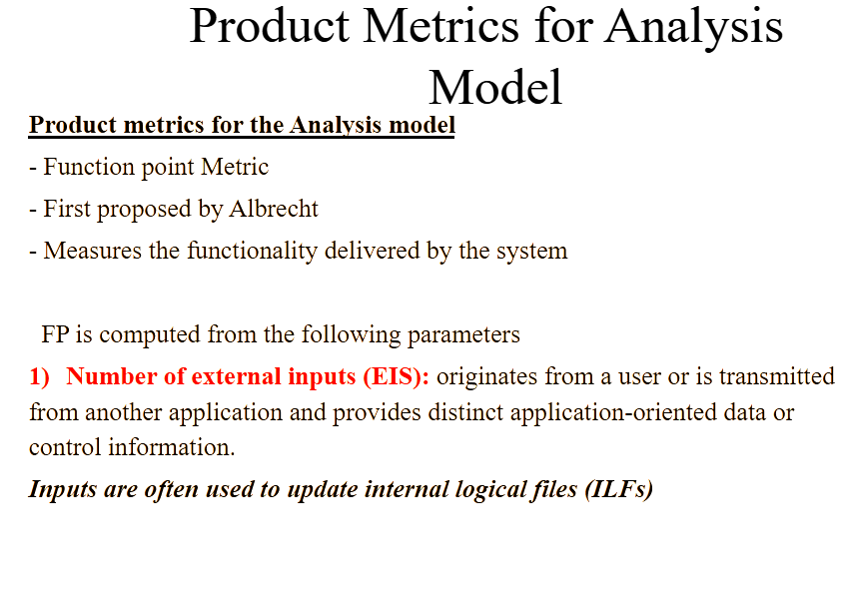
Product Metrics for analysis , Design , Test and maintenance

Slide 7
Product metrics for the Analysis model
2) Number external outputs (EOS): Is derived within the application and provides information to the user (like processing the logic, retrieval of data and controlling information)
External outputs refers to reports, screens, error messages etc
3) Number of external Inquiries (EQS): Is defined as an on-line input that results in the generation of some immediate software response in the form of an on-line output (often retrieved from an ILF)

Slide 8
Product metrics for the Analysis model
Counting Development Function Points
SRS
Identify Data Functions And Determine complexity
ILF &EIF
Identify Transaction Functions and Determine complexity
EI, EO & EQ
Compute Unadjusted Function Points
Rate on 14 General System Characteristics
Compute Value Adjustment Factor (VAF)
Compute the Function Point Count (FPC)

Slide 9
4) Number of Internal Logical Files (ILF): "An ILF is a user-identifiable group of logically related data or control information maintained within the boundary of the application.”
Examples of ILFs
Samples of things that *can* be ILFs include:
1. Tables in a relational database.
2. Flat files.
3. Application control information, perhaps things like user preferences that are stored by the application.

Slide 10
5) Number of external interface files (EIFS): "An external interface file (EIF) is a user identifiable group of logically related data or control information referenced by the application, but maintained within the boundary of another application.”
This means an EIF counted for an application must be in an ILF in another application."
Each parameter is classified as simple, average or complex and weights are assigned as follows

Slide 11
Function Point Computation
1) Identify/collect the information domain values
2) Complete the table shown below to get the count total
Associate a weighting factor (i.e., complexity value) with
each count based on criteria established by the software
development organization
3) Evaluate and sum up the adjustment factors (see the next two slides)
“F_{i}” refers to 14 value adjustment factors, with each
ranging in value from 0 (not important) to 5 (absolutely
essential)
4) Compute the number of function points (FP)
FP = count total * [0.65 + 0.01 * sum(F_{i})]

Slide 12
Identify Data Functions and Determine their complexity
Information Domain Count Simple average Complex
EIS 3 4 6
EOS 4 5 7
EQS 3 4 6
ILFS 7 10 15
EIFS 5 7 10
FP=Count total *[0.65+0.01*sum(Fi)]

Slide 13
Value Adjustment Factors
Does the system require reliable backup and recovery?
Are specialized data communications required to transfer information to or from the application?
Are there distributed processing functions?
Is performance critical?
Will the system run in an existing, heavily utilized operational environment?
Does the system require on-line data entry?
Does the on-line data entry require the input transaction to be built over multiple screens or operations?
(More on next slide)

Slide 14
Value Adjustment Factors (continued)
Are the internal logical files updated on-line?
Are the inputs, outputs, files, or inquiries complex?
Is the internal processing complex?
Is the code designed to be reusable?
Are conversion and installation included in the design?
Is the system designed for multiple installations in different organizations?
Is the application designed to facilitate change and for ease of use by the user?

Slide 15
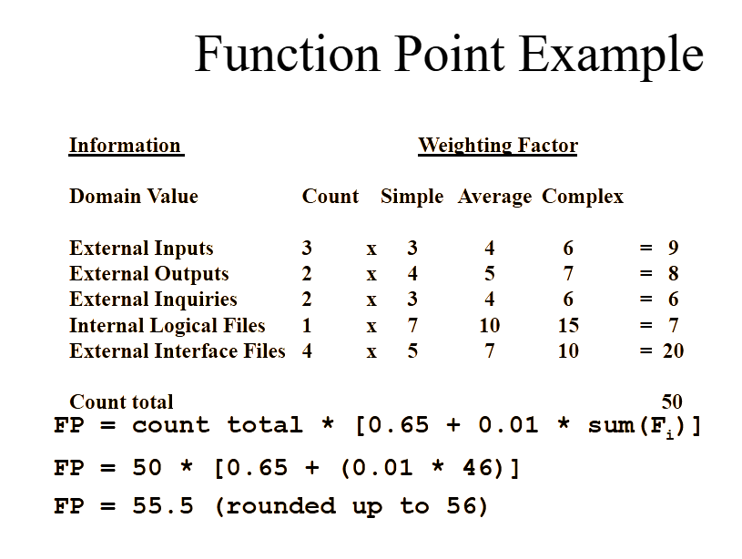
Compute unadjusted function points:

Slide 16
Product metrics for Design
These metrics place emphasis on the architectural structure and effectiveness of modules or components within the architecture
They are “black box” in that they do not require any knowledge of the inner workings of a particular software component
Card and Glass define three software design complexity measures.

Slide 17
Hierarchical Architecture Metrics
Fan out: the number of modules immediately subordinate to the module i, that is, the number of modules directly invoked by module
Structural complexity
  S(i) = f²_{out}(i), where f_{out}(i) is the “fan out” of module
Data complexity
  D(i) = v(i)/[f_{out}(i) + 1], where v(i) is the number of input and output variables that are passed to and from module
System complexity
  C(i) = S(i) + D(i)
As each of these complexity values increases, the overall architectural complexity of the system also increases
This leads to greater likelihood that the integration and testing effort will also increase

Slide 18
Hierarchical Architecture Metrics (continued)
Shape complexity
  size = n + a, where n is the number of nodes and a is the number of arcs
  Allows different program software architectures to be compared in a straightforward manner
Connectivity density (i.e., the arc-to-node ratio)
  r = a/n
  May provide a simple indication of the coupling in the software architecture

Slide 19
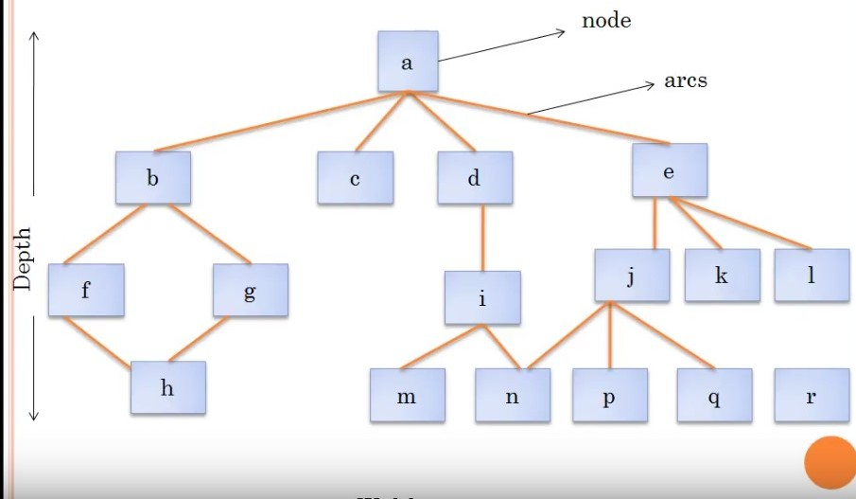

Slide 20
Size= 17+18=35
Depth=4, the longest path from the root (top) node to a leaf node
Width=6, Maximum number of nodes at any one level of the architecture
R=a/n
R=18/17=1.06

Slide 21
METRIC FOR SOURCE CODE
HSS(Halstead Software science)
Primitive measure that may be derived after the code is generated or estimated once design is complete
n₁ = the number of distinct operators that appear in a program
n₂ = the number of distinct operands that appear in a program
N₁ = the total number of operator occurrences.
N₂ = the total number of operand occurrence.
Overall program length N can be computed:
N = n₁ log2 n₁ + n₂ log2 n₂
Program Volume may be defined
V = N log₂ (n₁ + n₂)

Slide 22
Halstead uses these primitive measures to develop expressions for the overall program length, potential minimum volume for an algorithm, the actual volume(number of bits required to specify a program),language level, and other features such as development effort, development time and even projected number of faults in the software.

Slide 23
Example
if (k < 2)
{
if (k > 3)
x = x*k;
}
Distinct operators: if ( ) { } > < = * ;
Distinct operands: k 2 3 x
n₁ = 10
n₂ = 4
N₁ = 13
N₂ = 7
n₁ = the number of distinct operators that appear in a program
n₂ = the number of distinct operands that appear in a program
N₁ = the total number of operator occurrences.
N₂ = the total number of operand occurrence

Slide 24
METRIC FOR TESTING
Program Level and Effort
PL = 1/[(n₁ / 2) x (N₂ / n₂ l)]
e = V/PL

Slide 25
METRICS FOR MAINTENANCE
M_{t} = the number of modules in the current release
F_{c} = the number of modules in the current release that have been changed
F_{a} = the number of modules in the current release that have been added.
F_{d} = the number of modules from the preceding release that were deleted in the current release
The Software Maturity Index (SMI), is defined as:
SMI = [M_{t – (}F_{c} + F_{a +} F_{d)/} M_{t} ]
As the SMI (i.e., the fraction) approaches 1.0, the software product begins to stabilize
The average time to produce a release of a software product can be correlated with the SMI

